Slide 1

Predicting Stock Market Direction from Financial News
Pranav Yellapragada Course: BA-530

Slide 2

Objective & Context
Goal: Predict next‑day S&P 500 direction (Up or Down) from daily financial news headlines.
Motivation: Evaluate whether investor sentiment in public news provides useful trading signals, challenging the semi‑strong form of the efficient market hypothesis.
Dataset: Combined_News_DJIA.csv with 1,989 trading days (2008–2016), containing the top 25 headlines per day and a label for next‑day DJIA movement.

Slide 3
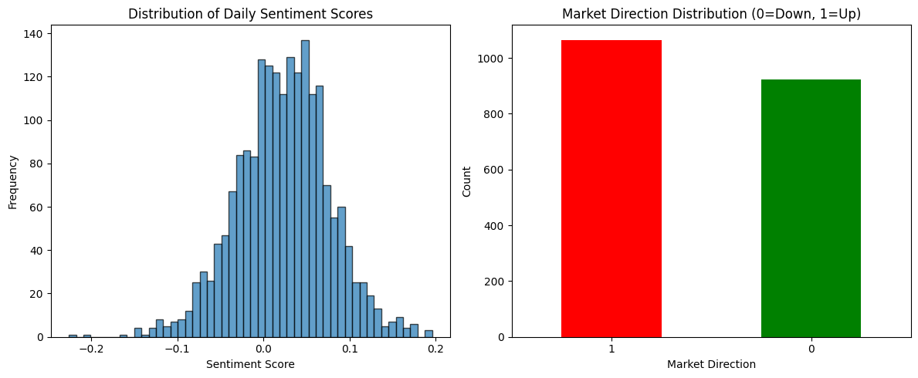
Data & Preprocessing
Concatenated 25 headlines per day into a single document and removed byte artifacts, quotes, and escape characters.
Parsed dates to maintain chronological order; used TextBlob to compute sentiment polarity, plus binary positive/negative flags and absolute sentiment magnitude.
The class distribution shows slightly more Down days (~54%) than Up days (~46%). The histogram of sentiment scores is nearly normal with a slight positive skew.

Slide 4

Methodology
Feature engineering:
Converted text to TF‑IDF vectors (unigrams and bigrams) using scikit‑learn’s TfidfVectorizer.
Added sentiment polarity, positive/negative flags, and absolute sentiment magnitude as numeric features.
Models:
Random Forest Classifier: Ensemble of decision trees, handles non‑linear patterns.
Logistic Regression: Linear classifier for baseline comparison.
Training/testing: Time‑series split (80 % train / 20 % test) to prevent look‑ahead bias; evaluation using accuracy, precision, recall, and ROC‑AUC.

Slide 5
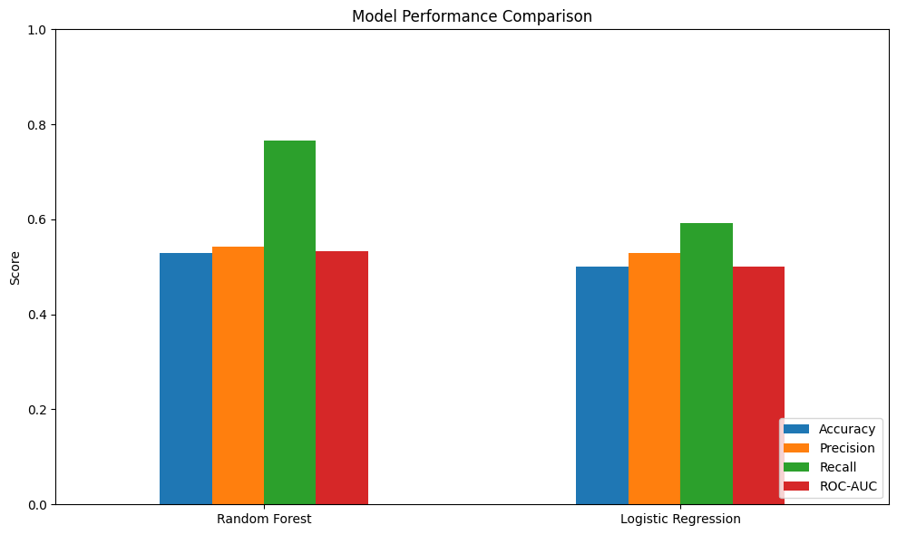
Results & Evaluation
Random Forest (test set): Accuracy ≈ 53 %, Precision ≈ 54 %, Recall ≈ 77 %, ROC‑AUC ≈ 0.53.
Logistic Regression: Accuracy ≈ 50 %, ROC‑AUC ≈ 0.50 (no better than random guessing).
Confusion matrices show that the Random Forest strongly favors predicting Up, leading to many false positives when the market actually goes Down.

Slide 6

The marginal improvement over random guessing indicates that daily sentiment has very weak predictive power for next‑day market direction.

Slide 7

Reflection & Business Implications
Lessons: Textual sentiment alone cannot reliably forecast daily market movements; the signal is too weak and noisy.
Challenges: Class imbalance and low feature‑target correlation caused bias toward predicting Up days and unstable performance across time.
Business takeaway: Do not base trading strategies solely on news sentiment. Combine text‑derived indicators with technical factors (e.g., volume, volatility) and macroeconomic variables. Advanced NLP models like FinBERT may capture more nuanced context.
Future work: Explore multi‑modal models, oversampling techniques for minority classes, and rolling averages of sentiment to capture lagged effects.

Slide 8
Conclusion
News sentiment alone does not consistently predict next‑day S&P 500 movements.
The project underscores the importance of rigorous data cleaning, proper temporal evaluation, and critical interpretation when applying AI in finance.

